Slide 1
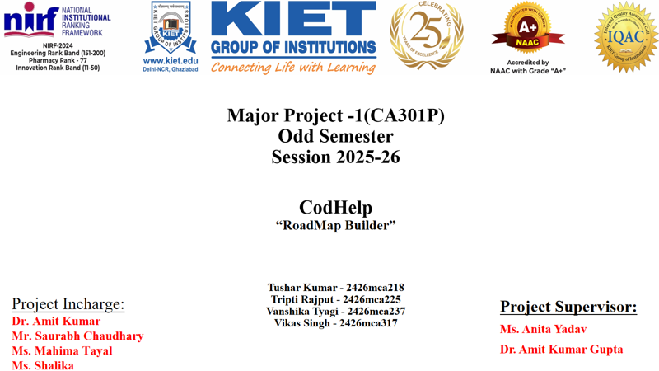
Notes:
1

Slide 2
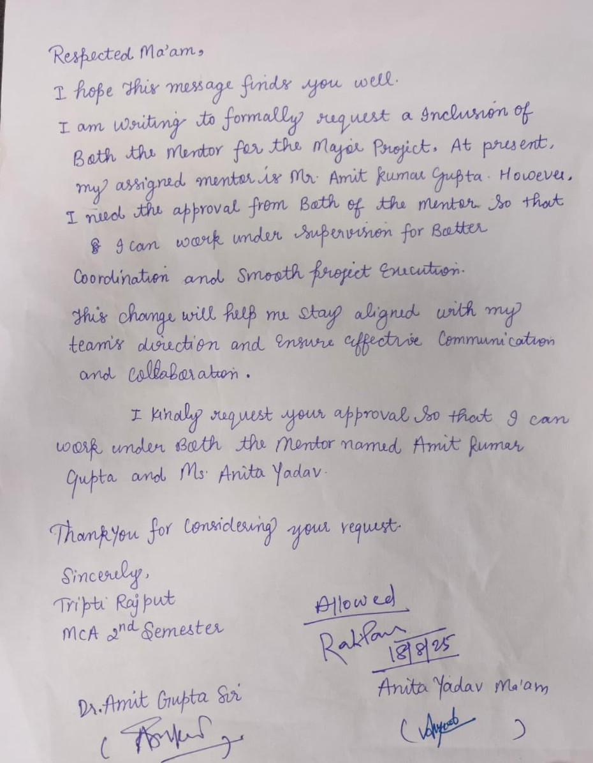
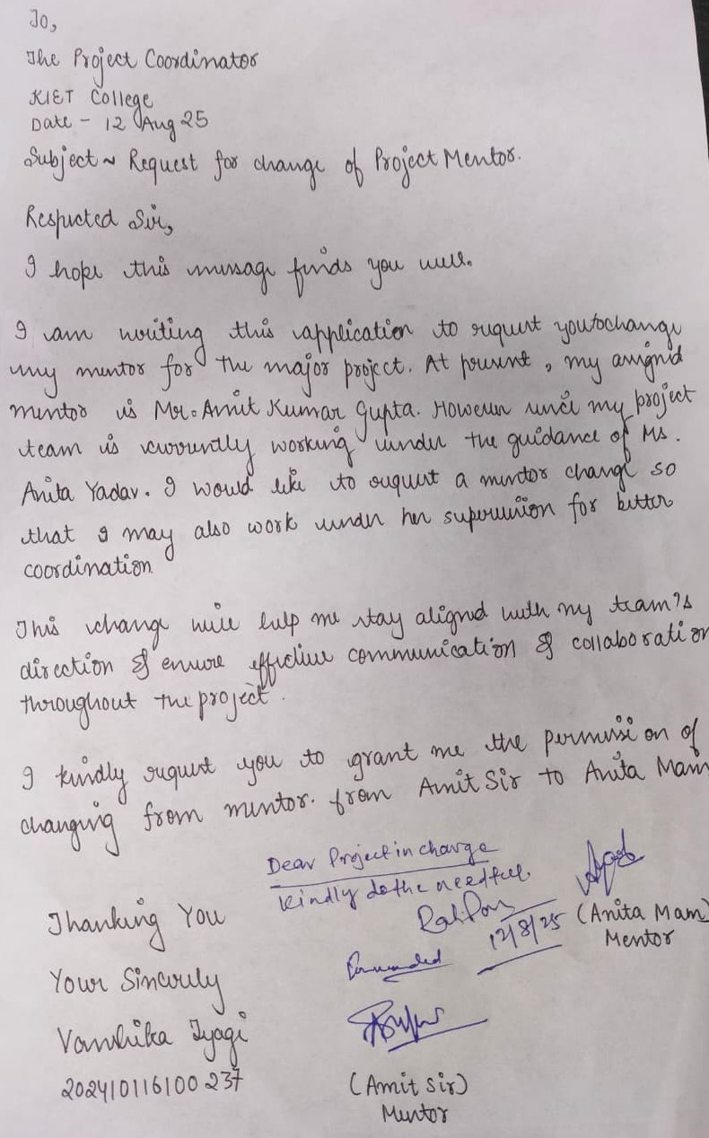
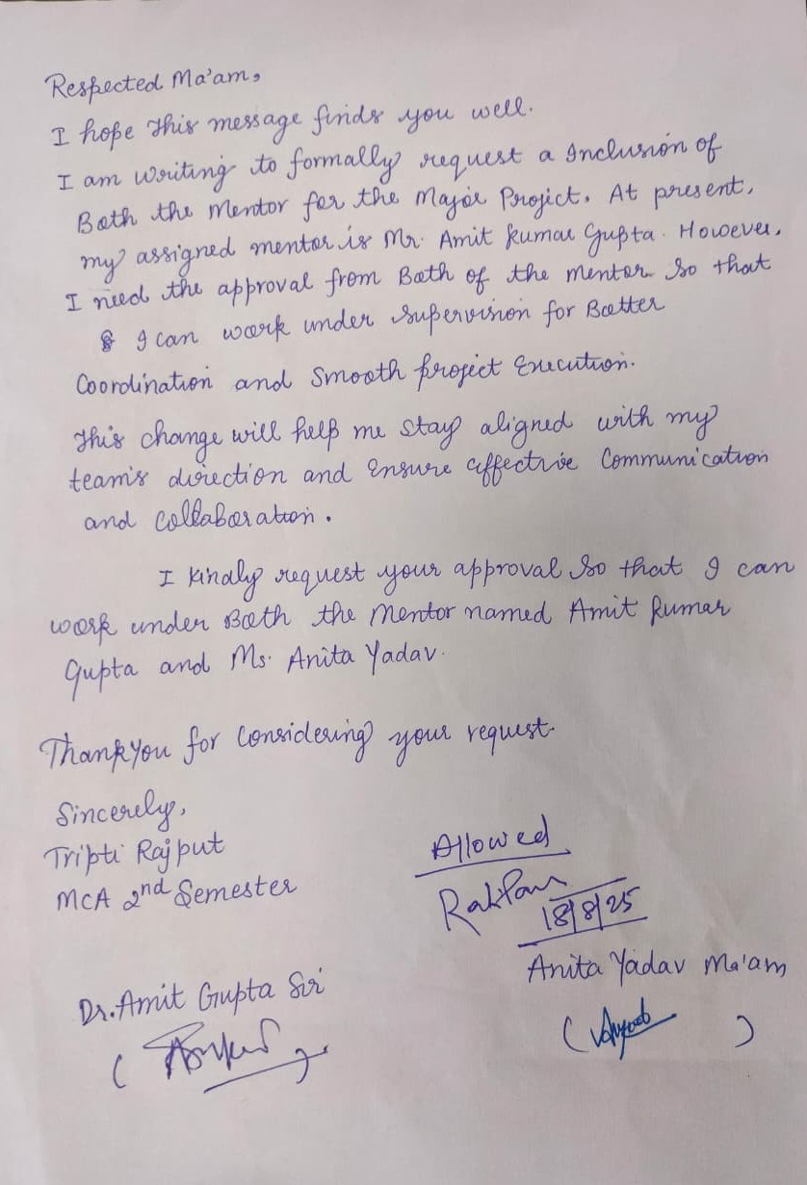
1
Notes:
1

Slide 3


AI-Powered Roadmap Builder
Smart Learning & Problem-Solving with AI, Videos & Interactive Files
2
Notes:
2

Slide 4
Evaluation Parameters
Each section of this presentation maps directly to the project rubric.
Problem Statement & Domain Understanding
15 Marks
Defined Objectives, Scope & Expected Outcomes
15 Marks
Methodology & Initial Implementation Progress
10 Marks
Research Outcome (Innovation / Publications / Patent)
10 Marks
Presentation Clarity & Quality
10 Marks
Total: 60 Marks
3
Notes:
3

Slide 5

Problem Statement & Domain Understanding
In today’s digital era, learners and professionals grapple with scattered and unstructured resources. Current AI tools offer isolated answers, failing to provide comprehensive step-by-step learning roadmaps. Educational platforms lack integration of interactive files, AI explanations, and structured outputs. This leads to confusion, wasted time, and inefficient learning.
Domain: EdTech + AI-driven Knowledge Management
Target Users: Students, Developers, Researchers/Professionals
Trend & Relevance: The global EdTech market demands personalized AI solutions, aligning directly with this project's vision.
4
Notes:
4

Slide 6
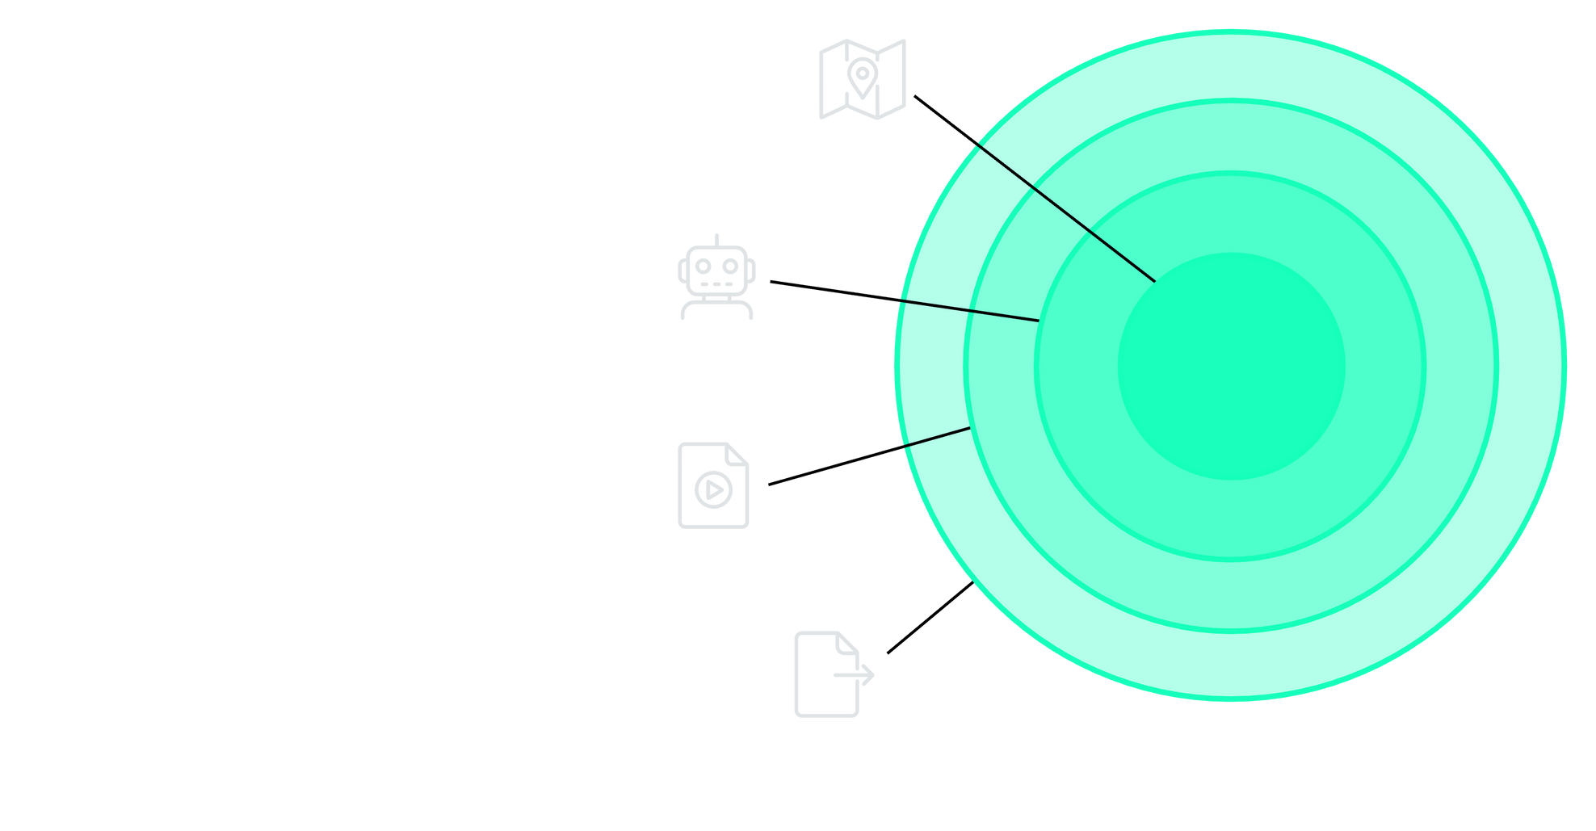




Defined Objectives
Core Objective
Clear learning roadmaps.
AI Guidance
Explainable AI-driven feedback.
Media Integration
Seamless video embedding.
Content Tools
File interaction and export.
5
Notes:
5

Slide 7
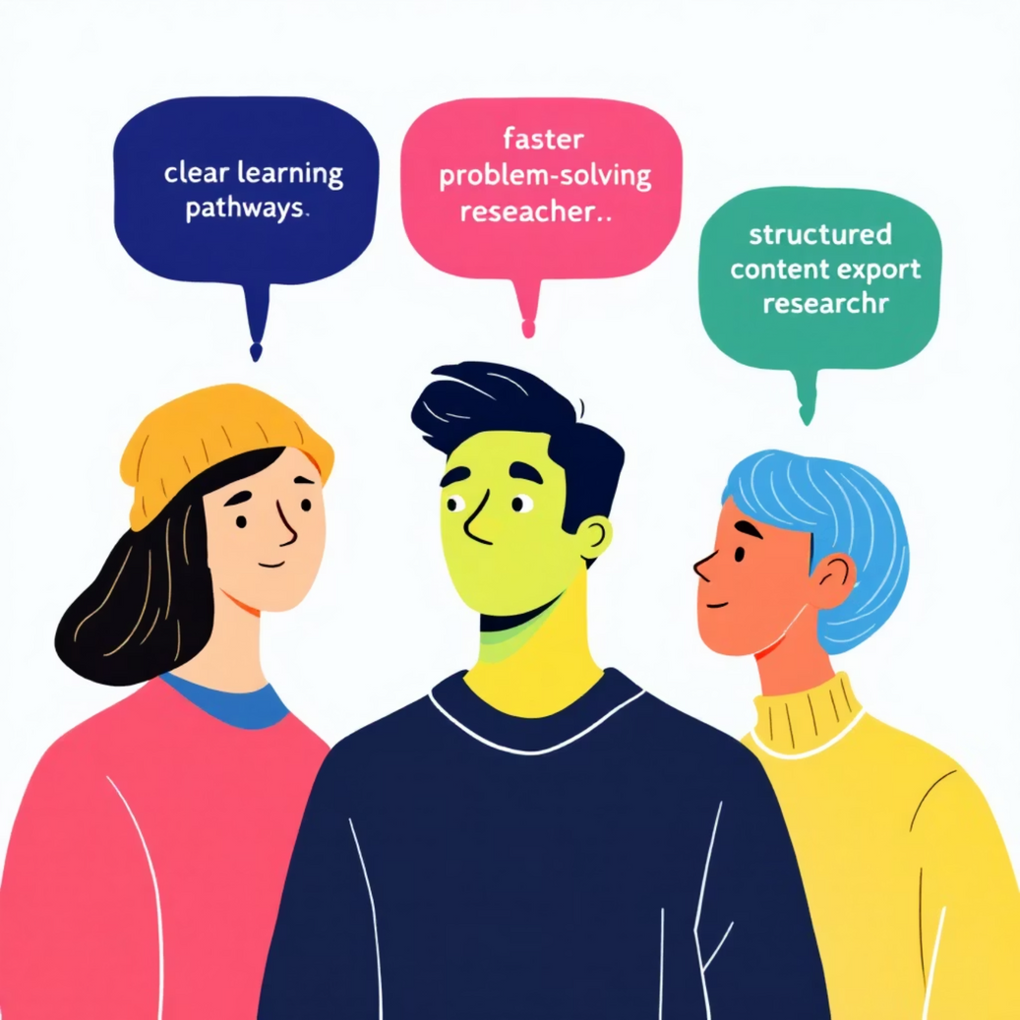



Scope & Expected Outcomes
Scope
Expected Outcomes
Students
Structured exam prep & project learning.
Developers
Mastering new technologies step by step.
Researchers/Professionals
Exploring new domains with clarity.
6
Clear learning pathways
Faster problem-solving
Personalized, AI-driven knowledge
Easy sharing/export of structured content
Notes:
6

Slide 8

Methodology & Tech Stack:
Chosen Technologies
System Architecture Flow
Our selection of technologies ensures a robust, scalable, and highly responsive platform, leveraging industry-standard tools and cutting-edge AI capabilities.
User Input
AI Roadmap
Frontend: React JS (for dynamic UI and server-side rendering)
Backend: Node.JS (for efficiency and AI integration)
Video Integration
Database: MongoDB atlas(for flexible, scalable data storage)
File & Export
AI: OpenAI API (for advanced natural language processing and roadmap generation)
This modular architecture allows for clear separation of concerns, facilitating development, testing, and future enhancements.
Export: JSON (for versatile content sharing)
This stack provides a solid foundation for delivering a feature-rich and performant user experience.
7
Notes:
7

Slide 9
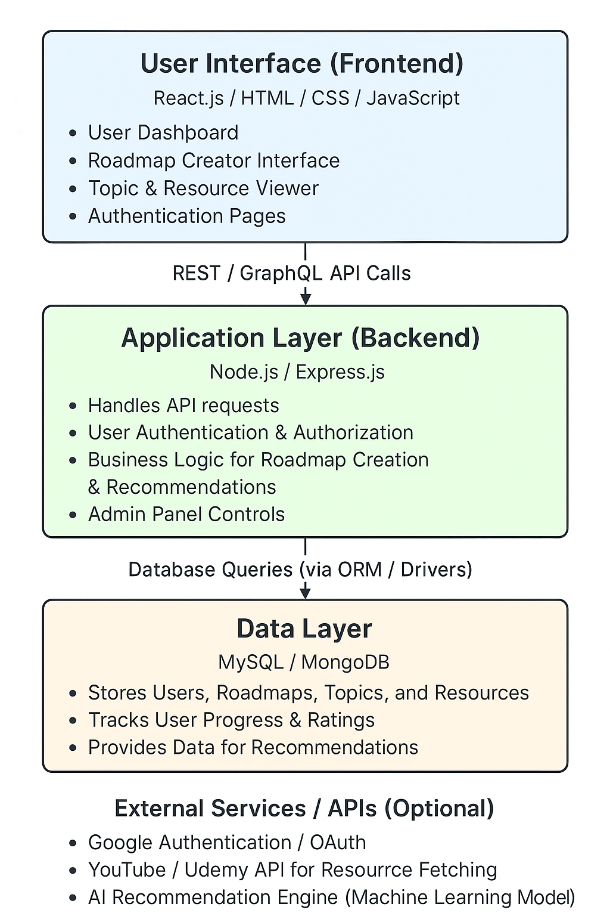
System Architecture – Roadmap Builder
The System Architecture of the Roadmap Builder describes how different components of the system — frontend, backend, database, and external services — interact to provide a seamless experience for users creating and exploring learning roadmaps.
It follows a three-tier architecture: Presentation Layer, Application Layer, and Data Layer.
8
Notes:
8

Slide 10
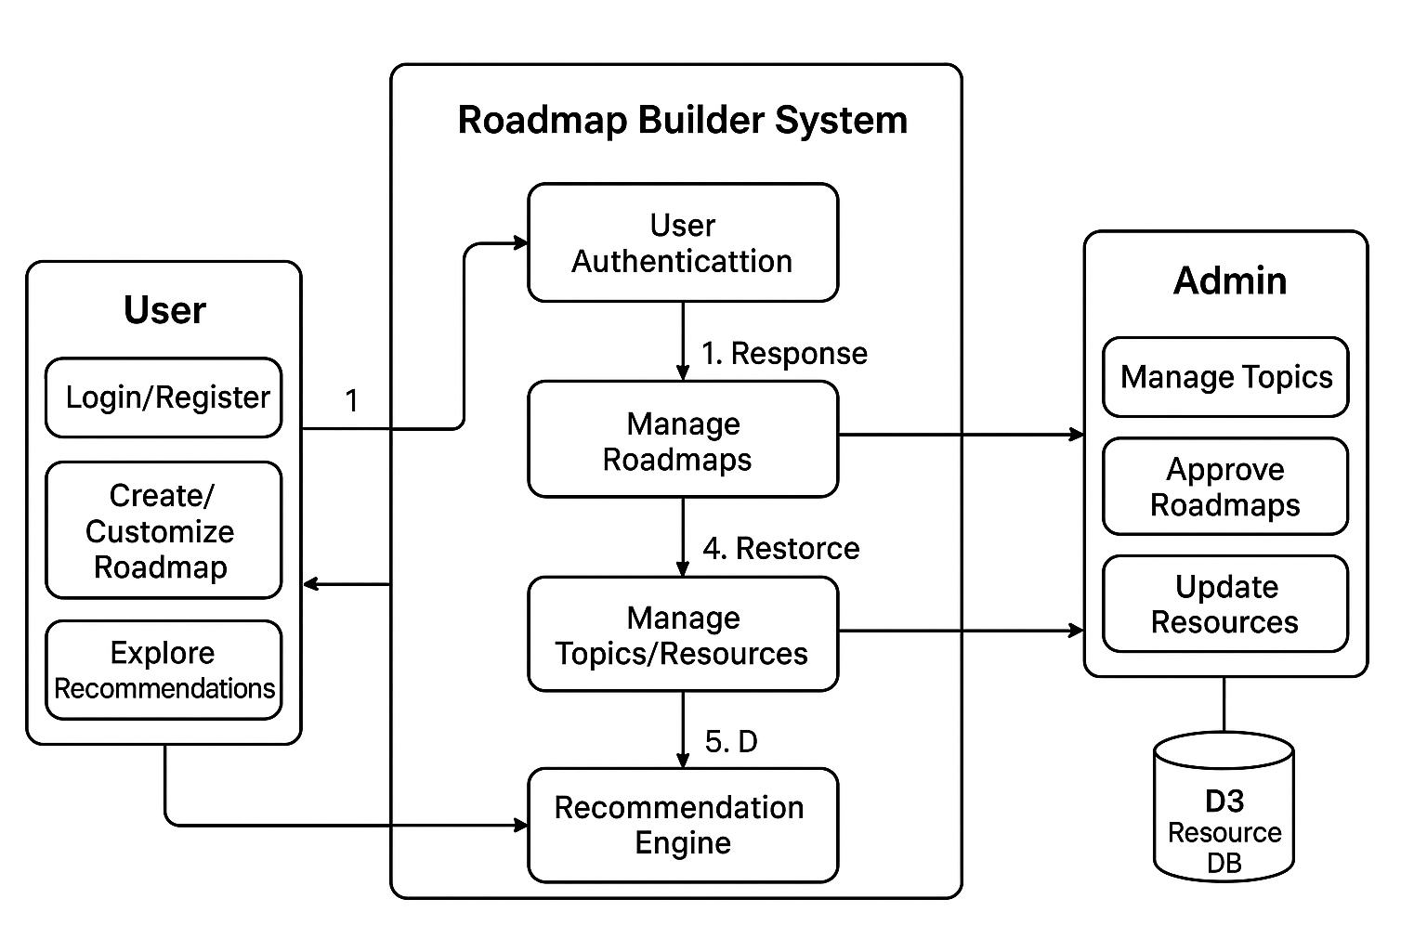
Data Flow Diagram:
At the highest level, the system functions as a central intelligence hub, seamlessly bridging the user with external services. It orchestrates inputs, processes, and resources—leveraging AI engines, video content, and databases—to generate personalized, dynamic, and interactive roadmaps that adapt to user needs
8
Notes:
8

Slide 11
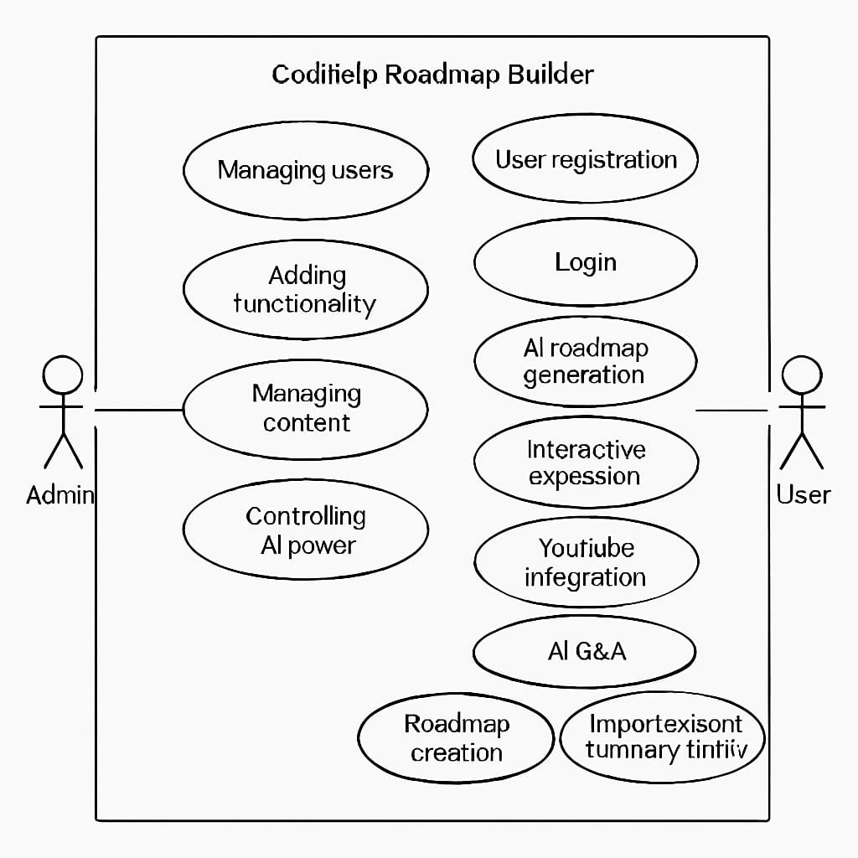
Use Case Diagram
This diagram shows how the User interacts with the system. The user can ask AI questions, integrate video lectures, generate roadmaps, download JSON/PDF, upload files, and interact with files. These actions connect with external systems like the AI Engine, YouTube API, and the Database to deliver personalized roadmaps and seamless file management.
9
Notes:
10

Slide 12
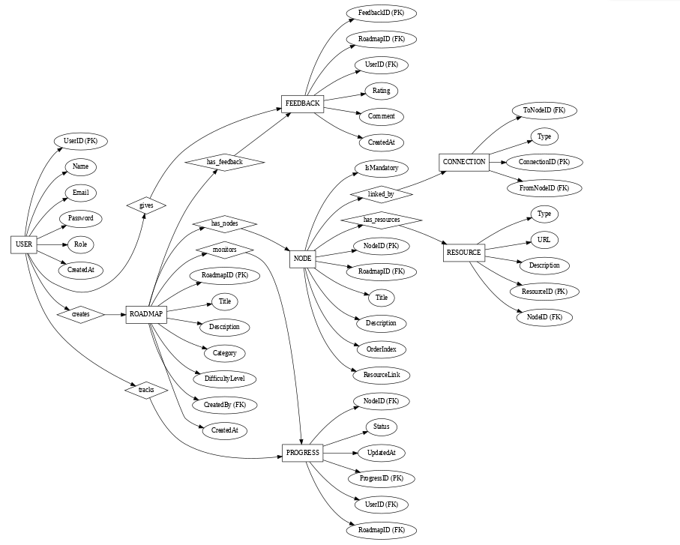
Entity–Relationship Diagram Overview
Understanding the foundational data model, where entities represent key system components and relationships define their interdependencies.
10
Notes:
11

Slide 13
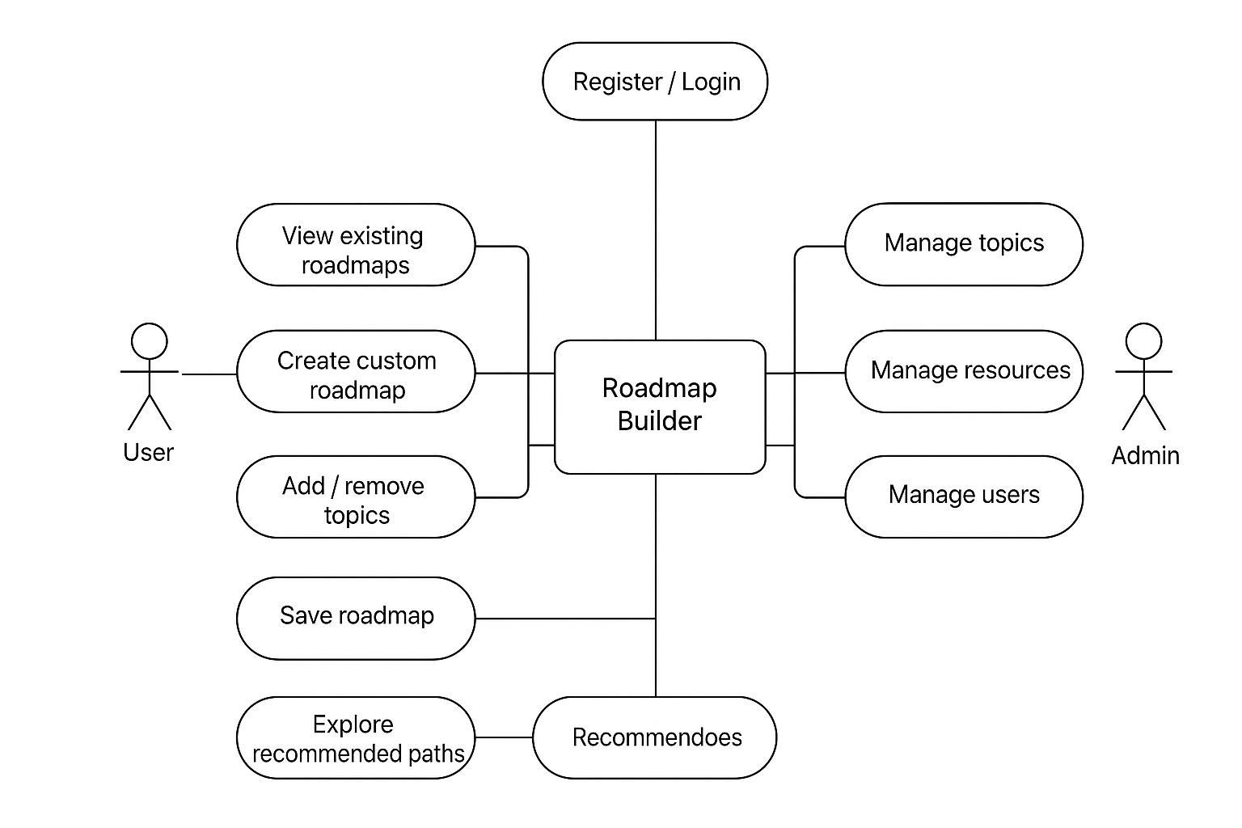
UML Diagram
A Use Case Diagram is a part of the Unified Modeling Language (UML) that represents the interaction between users (actors) and the system to achieve specific goals. It focuses on what the system does from the user’s perspective, not how it does it.
10
Notes:
11

Slide 14


Key Entities & Attributes
User
Roadmap
Topic
user_id (PK)
roadmap_id (PK)
topic_id (PK)
name
title
name
email
description
difficulty_level
created_date
11
Notes:
12

Slide 15
Resource
File
Export
resource_id (PK)
file_id (PK)
export_id (PK)
title
filename
format
link
type
generated_date
duration
uploaded_date
12
Notes:
13

Slide 16
Relationships & Cardinality
Crow's foot notation clarifies the powerful one-to-many connections that enable a rich, interconnected learning experience.
User creates Roadmap (1:N)
Topic linked with Resource (1:N)
A single user can create multiple unique roadmaps.
A topic can be supported by numerous relevant learning resources.
Roadmap contains Topics (1:N)
Roadmap interacts with File (1:N)
Each roadmap is composed of several distinct topics.
A roadmap can reference or be informed by multiple uploaded user files.
Roadmap generates Export (1:N)
A single roadmap can be exported in various formats over time.
13
Notes:
14

Slide 17
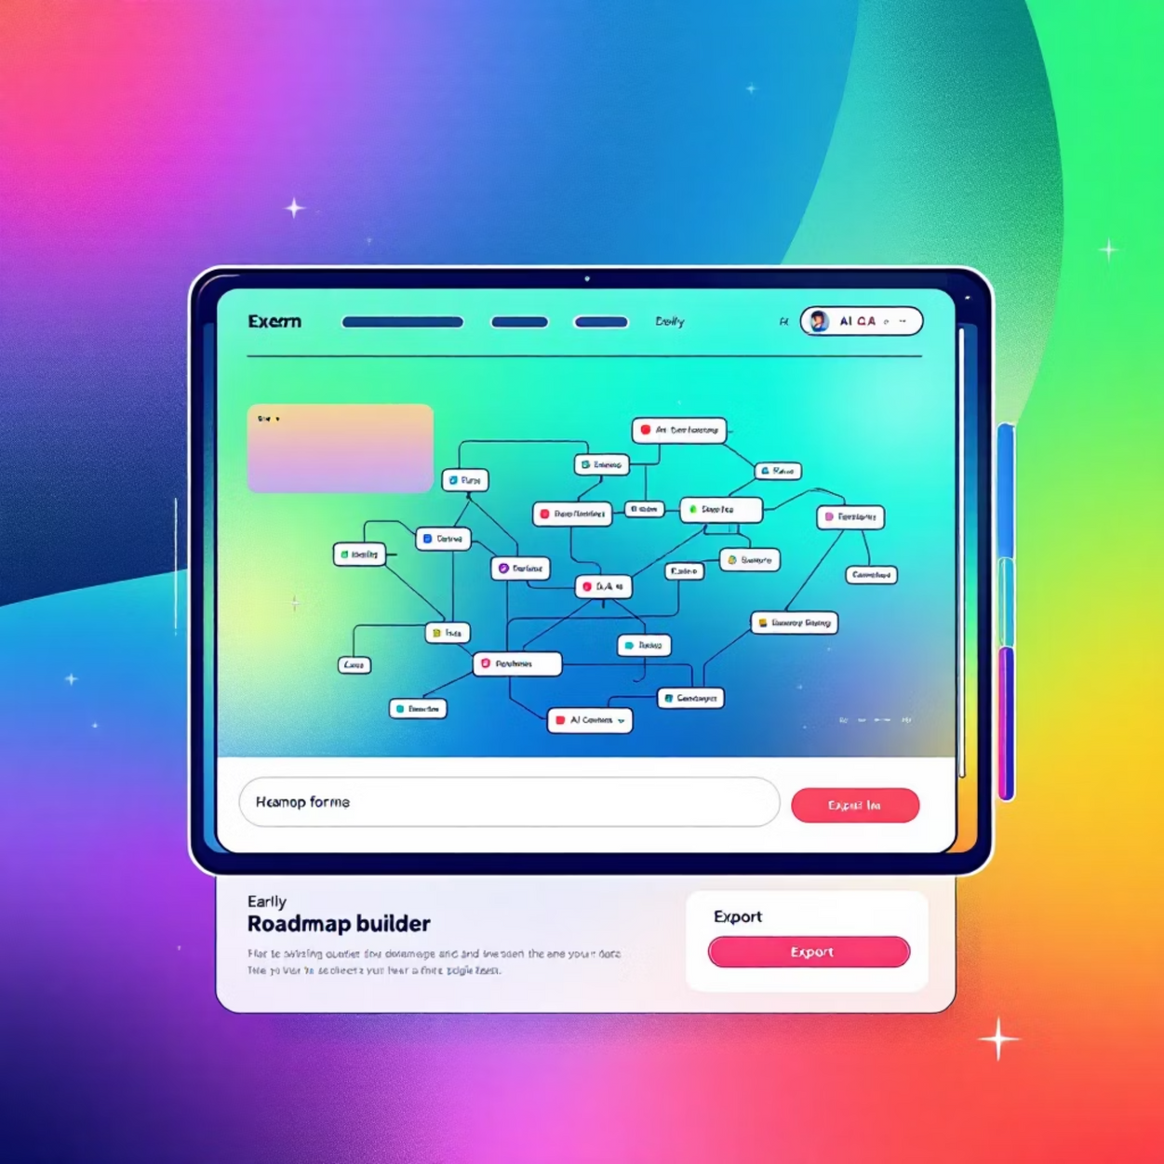
Initial Implementation Progress
Key Achievements
Functional roadmap visualization UI
Basic AI Q&A demonstration
Initial JSON/PDF export capabilities
Next Steps
Developing advanced personalization features
Implementing collaborative learning functionalities
Conducting user testing and gathering feedback
14
Prototype: Roadmap Visualization UI with AI Q&A and Export Options
Notes:
15

Slide 18



Research Outcome & Innovation
Core Innovation: Unifying Disparate Features
Future Research Directions
The AI-Powered Roadmap Builder stands as a unique solution by being the first tool to seamlessly combine:
Dynamic AI-driven roadmap generation
Interactive AI Q&A capabilities
Adaptive AI Tutors
Direct integration with YouTube video lectures
Developing AI agents that provide personalised, real-time tutoring based on user learning patterns.
Robust file interaction and analysis
Structured content export functionality
This comprehensive integration addresses the fragmented nature of current learning tools, offering an unparalleled, unified learning ecosystem.
AI-Based Personalised Learning Roadmaps
Advanced algorithms for highly customised learning paths, adapting dynamically to individual progress and knowledge gaps.
Potential Research Publications & Patents
The novel integration and AI-driven methodologies present strong opportunities for academic publications and intellectual property protection.
15
Notes:
16

Slide 19




Conclusion: The Future of Learning
Roadmap Builder = Learning + AI + Videos + Files = Smart Knowledge Solution
Integrated Solution
Unique & Scalable
Future Direction
Roadmap Builder = Learning + AI + Videos + Files
A novel approach to structured knowledge acquisition.
MVP → User Testing → Scaling & Expansion.
Next Steps:
Minimum Viable Product (MVP) Development: Focus on core functionality.
User Testing & Feedback: Iterative refinement based on real-world use.
Strategic Scaling: Expanding features and user base post-launch.
The AI-Powered Roadmap Builder is a smart knowledge solution for the digital age.
16
Notes:
17

Slide 20


Thank You!
For your time and attention.
17
Notes:
18

